Slide 1
Professional & Scientific Council Update
October 6, 2016

Slide 2
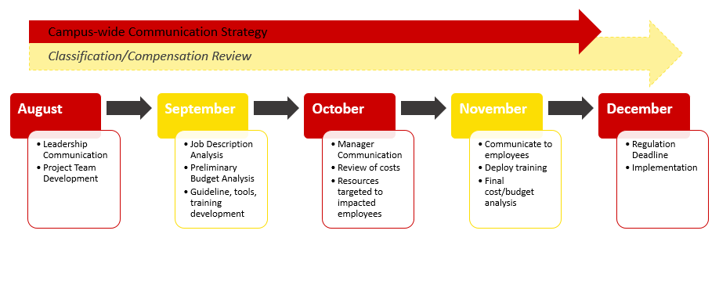
FLSA Project Timeline – Phase 1

Slide 3
FLSA Project Overview
All teams have met at least once. Some teams have met multiple times.
FLSA Website live - Please continue to check in for updates http://www.hrs.iastate.edu/hrs/flsa
Currently gathering info from some supervisors
November 1 target for final communications to impacted staff/supervisors

Slide 4
Open Change and Flu Shots
OPEN CHANGE OPPORTUNITIES
Non-Supervisory Merit
Open change period begins October 17, 2016 at 9:00 a.m. and closes on November 18, 2016 at 5:00 p.m.
Live webcast, November 2, 2016 (9:00-10:30 a.m.)
ISU Plan (Faculty, P&S, etc.)
Open change period begins November 1, 2016 at 9:00 a.m. and closes on November 18, 2016 at 5:00 p.m.
Live webcast, November 11, 2016 (9:00-10:30 a.m.)
FLU SHOT OPPORTUNITY
Occupational medicine staff will administer flu shots (while supplies last) at no cost to employees weekdays, from Oct. 10 to Oct. 21. 9 a.m. to 4 p.m., 205 Technical and Administrative Services Facility). Please bring your ISU ID card to the clinic.

Slide 5
Lactation Spaces Receive Updates
Last spring, employees from university human resources (UHR) and facilities planning and management (FPM) began to outline a coordinated approach to improve the lactation spaces.
Over the summer, FPM managed remodeling efforts for half of the university's 18 permanent lactation spaces. The unit also provided $32,000 to create a new lactation space in Atanasoff Hall
In addition, FPM added many U.S. Department of Labor (DOL) standards to the rooms, including an electrical outlet, chair, table, privacy curtain or door, and made sure they were compliant with the Americans with Disabilities Act.
Guidelines for lactation spaces, including what unit or units will be responsible for ongoing administration and funding are in the works within UHR and FPM.
A plan for adding more spaces on campus also is being developed.

Slide 6
Questions and Comments

