Slide 1
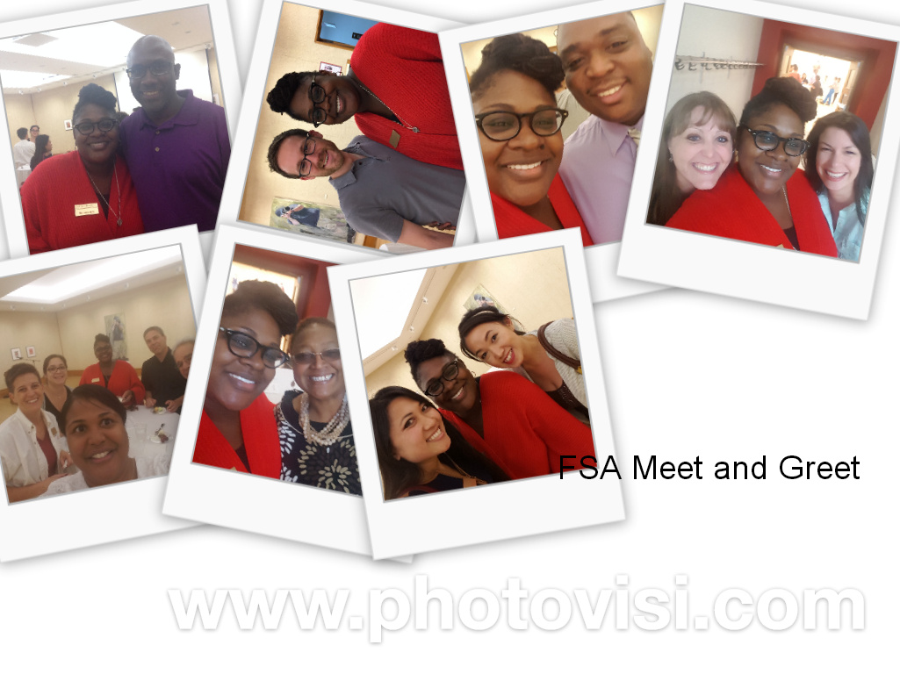
FSA Meet and Greet

Slide 2
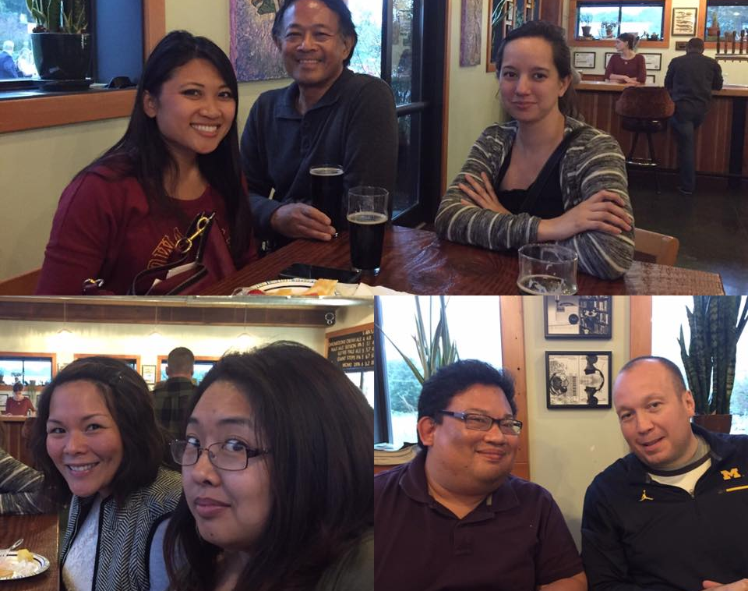
AAPI FSA
AAPI FSA had a great time at the Social last Friday at Alluvial
Next meeting on Thursday, October 20 (location tbd) from 12-1pm (feel free to bring your own lunch) where we will discuss upcoming events.

Slide 3


Slide 4
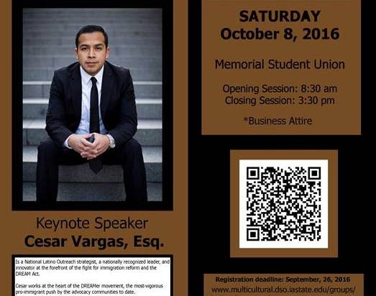
Black and Brown Male Empowerment Symposium
The target audience for the symposium is for individuals that identify as black and brown males. But the symposium is open to everyone. We're particularly targeting first year students, undergraduates, graduate students, faculty, staff and administration.

Slide 5
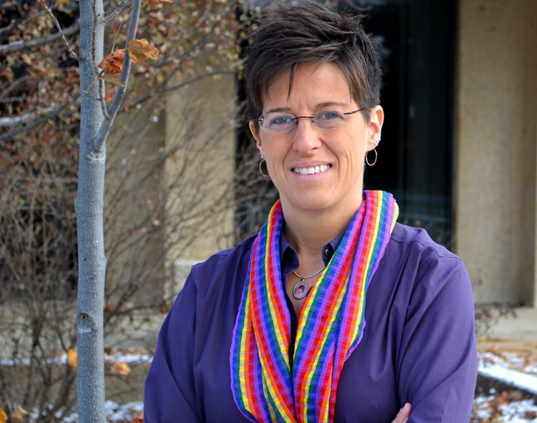
Nicci Port
Project Director for
LGBTQA+
Nicci Port serves as Project Director for Diversity and Inclusion. Her focus is on matters that are important to the LGBTQ+ community in support of ISU’s efforts to develop and sustain a more comprehensively inclusive environment aligned with the university’s strategic plan.

Slide 6
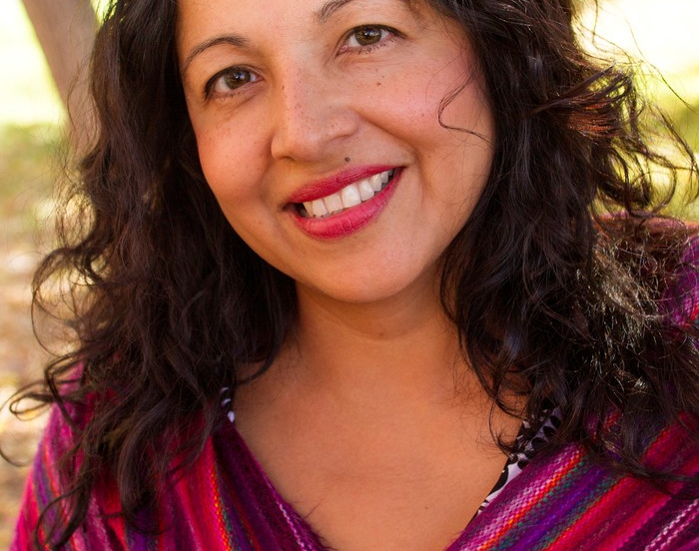
Dr. Liz Mendez-Shannon Project Director in Hispanic/Latinx Affairs
Dr. Liz Mendez-Shannon is the Diversity and Inclusion Project Director in Hispanic/Latinx Affairs. Prior to joining Iowa State University, Dr. Liz served as an Associate Professor at Metropolitan State in their Social Work Department. Having worked in Harlem, New York as a Program Director, she brings a wealth of social work experience and leadership in two key areas: Latinx issues and integrated health care. She is an awardee of grants including one from the Council of Social Work Education called HEALS (Healthcare and Leadership Scholars) which offers scholarships for social work students specializing in health care.

Slide 7
Fall 2016 Diversity Resource Fair
Theme: “Celebrating Diversity, C​Yde by C​Yde”
The event will feature student organizations, university departments, and community organizations related to diversity and inclusion. This includes organizations centered around race, ethnicity, gender, sexuality​, and more. This is a great opportunity for your respective organizations to recruit new members, allow your organization to promote itself to the general public, and a chance to learn about resources at Iowa State University pertaining to diversity​ and inclusion.​ The event will feature keynote speakers, interactive activities, and free food!​
Below are the details of the event:
WHAT: Diversity Resources Fair
WHEN: Tuesday, October 11, 5:00-7:00pm
WHERE: Sun Room, Memorial Union
Please contact Ben Faiz, Student Government Director of Diversity and Inclusion (benfaiz@iastate.edu), with any questions.

Slide 8
Announcements
SAVE THE DATE. DR. GEORGE JACKSON MEMORIAL PROGRAM. Saturday, November 12, 5 pm. More information to follow.
Thomas Hill, who was awarded the Impact Award by the ISU Alumni Association.
BFSA Meeting Thursday, October 20, 2016 in 1155 Administrative Services Building
Colegas Meeting Monday, November 7, 2016 in Room 2210, Memorial Union

