Slide 1
Hate Crimes 101
This educational workshop, presented by an ISU Police Multicultural Liaison Officer, will cover the State of Iowa statutes related to Hate Crimes, charging requirements, and reporting options. We will also cover ISU resources for victims of hate crimes or hate incidents. In addition, there will be time to discuss events that may not meet Iowa law’s specifications of Hate Crimes, but negatively affect the campus climate and some of the options for addressing those events or behaviors.
Session 2:
Carver 0101
12/05/2016 4:10 - 5:00 p.m.
If you have any questions specifically regarding this event, please contact me at ndgreene@iastate.edu.

Slide 2
Notice
The Office of Equal Opportunity is the Operational Manager for the Campus Climate Response Team. The hotline 515-294-1222 is now available. The website TBD.

Slide 3
Call for Proposal –Women’s and Diversity Grants Program
This program is designed to support initiatives that will enrich the experiences of women and diverse faculty, staff, and students at Iowa State University. Grant funding is available in support of women’s and diversity initiatives for either one-time programming or as seed money to stimulate additional funding from other sources.
Guidelines, application form and timeline are available at: http://www.diversity.iastate.edu/global/women-s-and-diversity-grants-program
Grant proposals may be submitted by ISU faculty or staff, as well as individuals or as teams, and at least one of the participants is required to have faculty or staff status. Individual grants will be awarded for up to $5,000 which must be expended between July 1, 2017 and June 30, 2018.
Deadline for submission of proposals is March 1, 2017.
Questions? Contact the office at 515-294-8840

Slide 4
Black FSA Winter Celebration
The Black Faculty and Staff Association cordially invite you and your family too:
A Soulful Winter Celebration!
Saturday, December 10, 2016, 6:00 p.m. - 11:00p.m.
At the Score Pavilion 1543 Fawcett Parkway Nevada, IA 50201
Also, we will have live music so bring your dancing shoes!
Please RSVP by December 4th
@ http://www.evite.com/event/034526NREBBLRYBZQEPGVQ6JODF4JQ/rsvp
The main entrees and beverages will be provided, but you are encouraged to sign up to bring a dish from the suggested categories on our Google Doc website (salads, desserts, breads, starches and vegetable sides).If you have any questions, please contact Kevin Lazard @ 515-294-4132.The BFSA looks forward to seeing you!

Slide 5
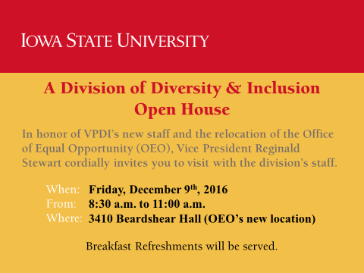
VPDI’s Open House

Slide 6
Resources
Anti-Racist Bystanter Intervention-#againsthate
Self Care

Slide 7
FSA Meetings
The FSA are not meeting in December, but will resume Spring Semester

