Slide 1
Policy Development and Approval Process
January 5, 2017

Slide 2
How do policies get developed at
Iowa State University?
Policy initiatives may arise from individuals, departments, constituent groups, or from changes in laws or regulations.
When the need for a new policy or policy revision is identified, the Policy Library Advisory Committee (PLAC) is to be notified so that it can serve as an adviser to policy developers and policy approvers.

Slide 3
Policy Library Advisory Committee
(PLAC)
Meets on a regular basis, as needed, to oversee and provide guidance regarding the development and content of university policies.
PLAC does not create or approve the policies.

Slide 4

PLAC Representation
Academic Affairs
Business and Finance
Faculty Senate Documents Committee
Faculty Senate President-Elect
Graduate and Professional Student Senate (GPSS)
Graduate Council
Internal Audit
Office of Equal Opportunity
Policy Administrator/President’s Office
Professional and Scientific Council Policies and Procedures Committee
Student Affairs
Student Government
University Counsel
University Human Resources

Slide 5

Policy Development Process and PLAC
PLAC will meet with policy developers for discussion at the following points in the policy development or revision process:
  Concept
  Policy Development Plan (PDP)
  Policy draft
Notes:
Concept
To assure that university officials will support the policy concept and the investment of human and other resources required for the policy’s development.
Policy Development Plan (PDP)
To assure the PDP incorporates consideration of all the significant factors and stakeholders relevant to development of the policy draft and implementation of the policy.
Policy draft
To assure that the policy as drafted:
Complies with all requirements of the Policy Library
Is stated and organized clearly and concisely
Serves the intended purpose

Slide 6
Policy Development Plan (PDP)
General Information
PDP Process
Policy Development Team
Policy Development
  Description
  Stakeholders
  Professional and Scientific Council response
Policy Adoption and Implementation
Approval of PDP

Slide 7
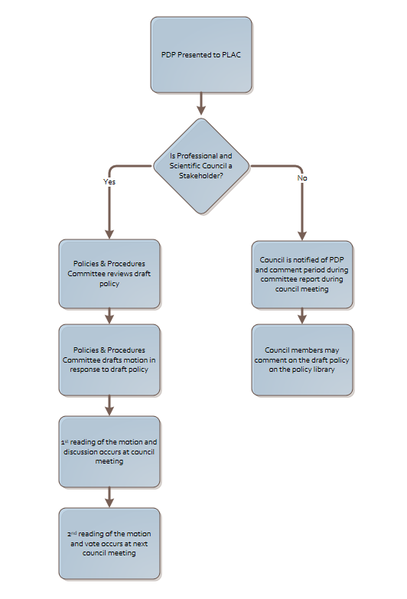
Role of Professional and Scientific Council

Slide 8
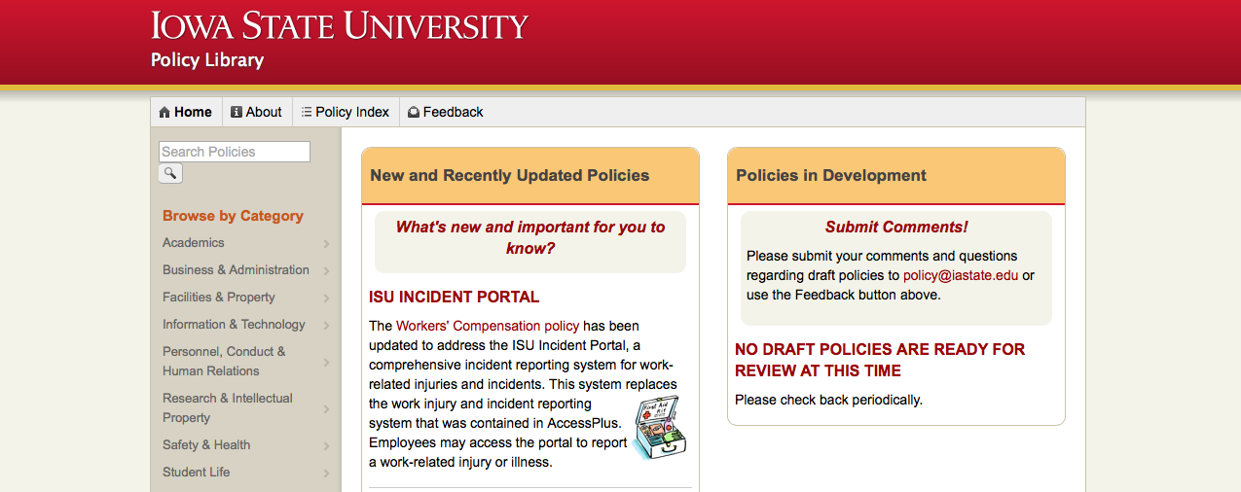
Submit Questions/Comments on Draft Policies

Slide 9
Final Approval and Implementation
At the conclusion of the policy development process, the policy administrator prepares and routes a Final Approval Form with the final draft of the policy for signature approval by university officials a provided in the PDP.
Following final approval, the policy is posted and announced in the Policy Library.

Slide 10

Questions

