Slide 1
FSA SPONSORED REFLECTION
The FSA Council will be hosting an open discussion forum for all ISU Faculty and Staff and Administration employee’s to come together and reflect on the various national events that took place during the fall semester. They hope this time will provide everyone a space to discuss feelings, thoughts and emotions as we prepare for the change of the country’s leadership. Feel free to come and go as your schedule allows. There will be members of the Office of Equal Opportunity (OEO) to help facilitate dialogue amongst the group.
Session 3:
Memorial Union, Gold Room
1/10/2017 12 p.m.
If you have any questions specifically regarding this event, please contact Corey Williamson at corey5@iastate.edu

Slide 2
UNIVERSITY AWARD FOR INCLUSIVE EXCELLENCE.
Nominate deserving individuals for the newly-created University Award for Inclusive Excellence. This university award recognizes faculty and P&S staff for their commitment to inclusion initiatives at Iowa State University. Give recognition to individuals who have advanced the university’s mission of diversity, equity, and inclusion by nominating them today!
Questions? Email Nicci Port @ nport@iastate.edu
Award Description can be found on the Provost’s website
http://www.provost.iastate.edu/faculty-and-staff-resources/awards/faculty/inclusive-excellence

Slide 3
Let Freedom Ring - Carillon Concert
Wednesday, January 11, 2017, 11:50 AM @ Central Campus - A carillon concert in honor of Dr. King. Tin-Shi Tam, carilloneur. Part of the Martin Luther King Jr. Legacy Series

Slide 4

Ames Community Celebration in honor of Dr. Martin Luther King, Jr
Celebrate with song, story and birthday cake. An Ames tradition! Join us at 5:30 for cake and music, with an hourlong program beginning at 6:00. Part of the Martin Luther King Jr. Legacy Series
Monday, January 16, 2017, 5:30 PM @ Ames Middle School, 3915 Mortensen Road

Slide 5
Dr. Martin Luther King, Jr., Legacy Convocation
Thursday, January 19, 2017, 3:30 PM @ Sun Room, Memorial Union - Celebrate the legacy of Dr. Martin Luther King, Jr., and learn how his global vision of equality for everyone remains relevant today. The Advancing One Community Awards will also be presented. Part of the Martin Luther King Jr. Legacy Series

Slide 6
What Are Your Rights? A Conversation
Monday, January 23, 2017, 7:00 PM @ Sun Room, Memorial Union - Opening remarks will be provided by ACLU of Iowa Legal Director Rita Bettis, and Corey Saylor, head of the Council of American Islamic Relations (CAIR) Department to Monitor and Combat Islamophobia. He is a national expert on countering Islamophobia and co-authored CAIR’s Islamophobia report, Confronting Fear. Then join us for a discussion of the constitutional and legal rights of Muslims. Students and others on campus are invited to share their own concerns, ask questions and help raise awareness about resources available on and off-campus during this uncertain post-election period. Clark Wolf, Iowa State professor in Philosophy and Political Science and director of Bioethics, will moderate the discussion.

Slide 7
Rap, Race, Reality & Technology - Chuck D
Thursday, January 26, 2017, 8:00 PM @ Great Hall, Memorial Union - Chuck D is leader and co-founder of legendary rap group Public Enemy and is known for creating politically charged and socially conscious hip hop music. As a rapper, producer, author, and social activist, Chuck D delivers a powerful message about race, rage and inequality. He is a national spokesperson for Rock the Vote, the National Urban League, and the National Alliance for African American Athletes. He is also co-author of Fight the Power: Rap, Race, and Reality. Chuck D redefined rap music and hip hop culture with the release of Public Enemy's debut album, Yo Bum Rush The Show, in 1987. Public Enemy was inducted into the Rock and Roll Hall of Fame in 2013.

Slide 8
A Deeper Black: Race in America - Ta-Nehisi Coates
Monday, January 30, 2017, 7:00 PM @ Great Hall, Memorial Union - Ta-Nehisi Coates is a national correspondent at The Atlantic, where his cover story on slavery and race, "The Case for Reparations," struck a national chord. His latest book, Between the World and Me, is written in the form of a letter to his teenage son about the challenges he will face growing up black in America. Coates is also the author of The Beautiful Struggle, a memoir about growing up in Baltimore with a father who was a Vietnam vet and Black Panther with his own underground black press. Coates is Journalist in Residence at the School of Journalism at CUNY and a former writer for The Village Voice, and a contributor to Time, O, and The New York Times Magazine. He was previously the Martin Luther King Visiting Associate Professor at MIT. Martin Luther King Jr. Legacy Series Keynote

Slide 9
NAACP Banquet-Registration Deadline January 17

Slide 10
Call for Proposal –Women’s and Diversity Grants Program
This program is designed to support initiatives that will enrich the experiences of women and diverse faculty, staff, and students at Iowa State University. Grant funding is available in support of women’s and diversity initiatives for either one-time programming or as seed money to stimulate additional funding from other sources.
Guidelines, application form and timeline are available at: http://www.diversity.iastate.edu/global/women-s-and-diversity-grants-program
Grant proposals may be submitted by ISU faculty or staff, as well as individuals or as teams, and at least one of the participants is required to have faculty or staff status. Individual grants will be awarded for up to $5,000 which must be expended between July 1, 2017 and June 30, 2018.
Deadline for submission of proposals is March 1, 2017.
Questions? Contact the office at 515-294-8840

Slide 11
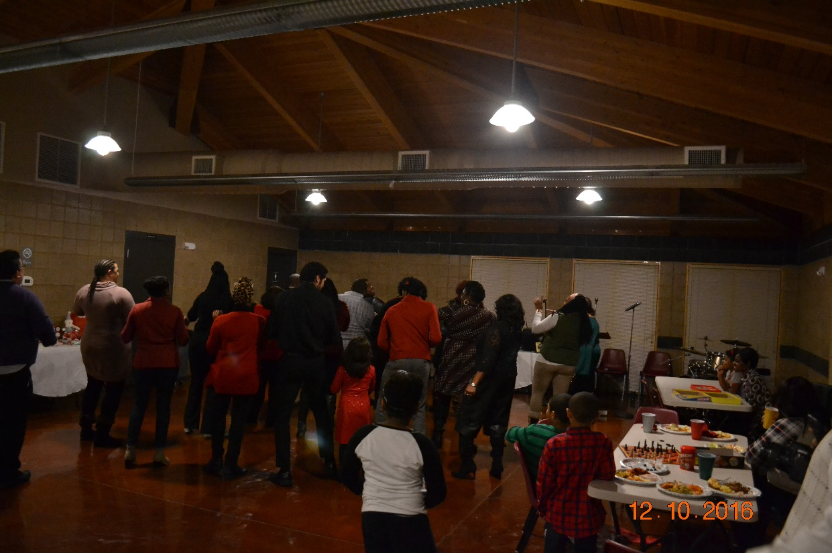
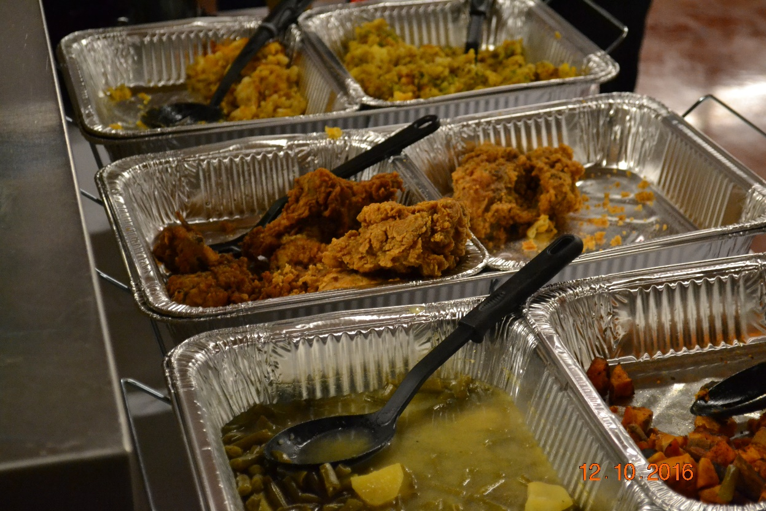
Black FSA Winter Celebration

Slide 12
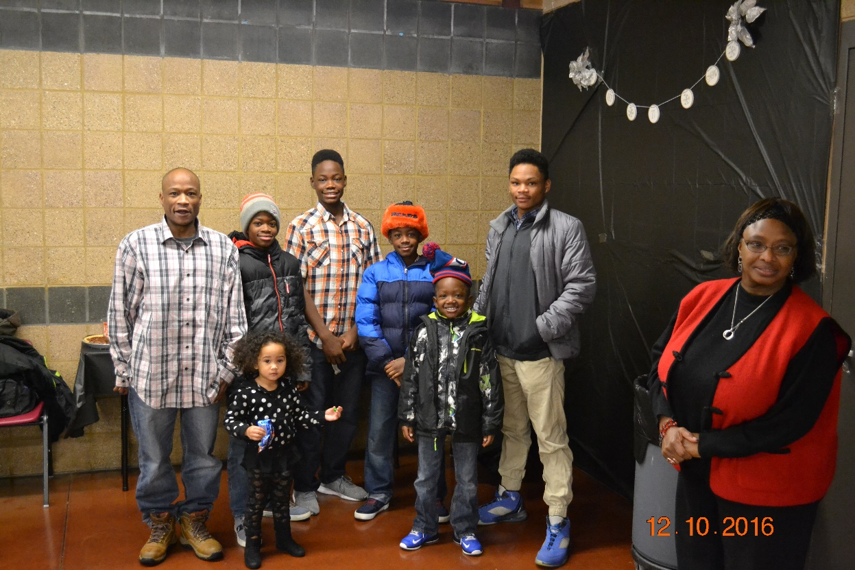
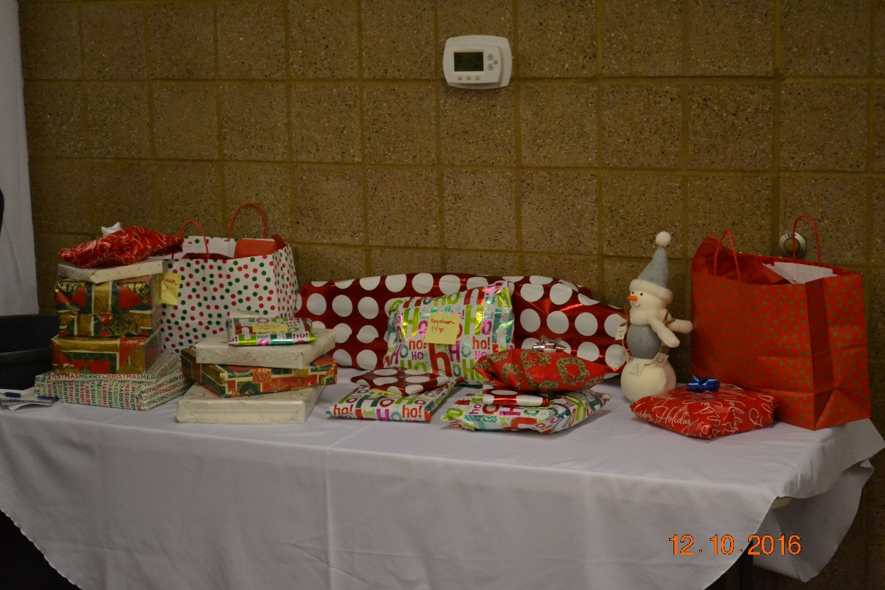
Family of the Year

Slide 13
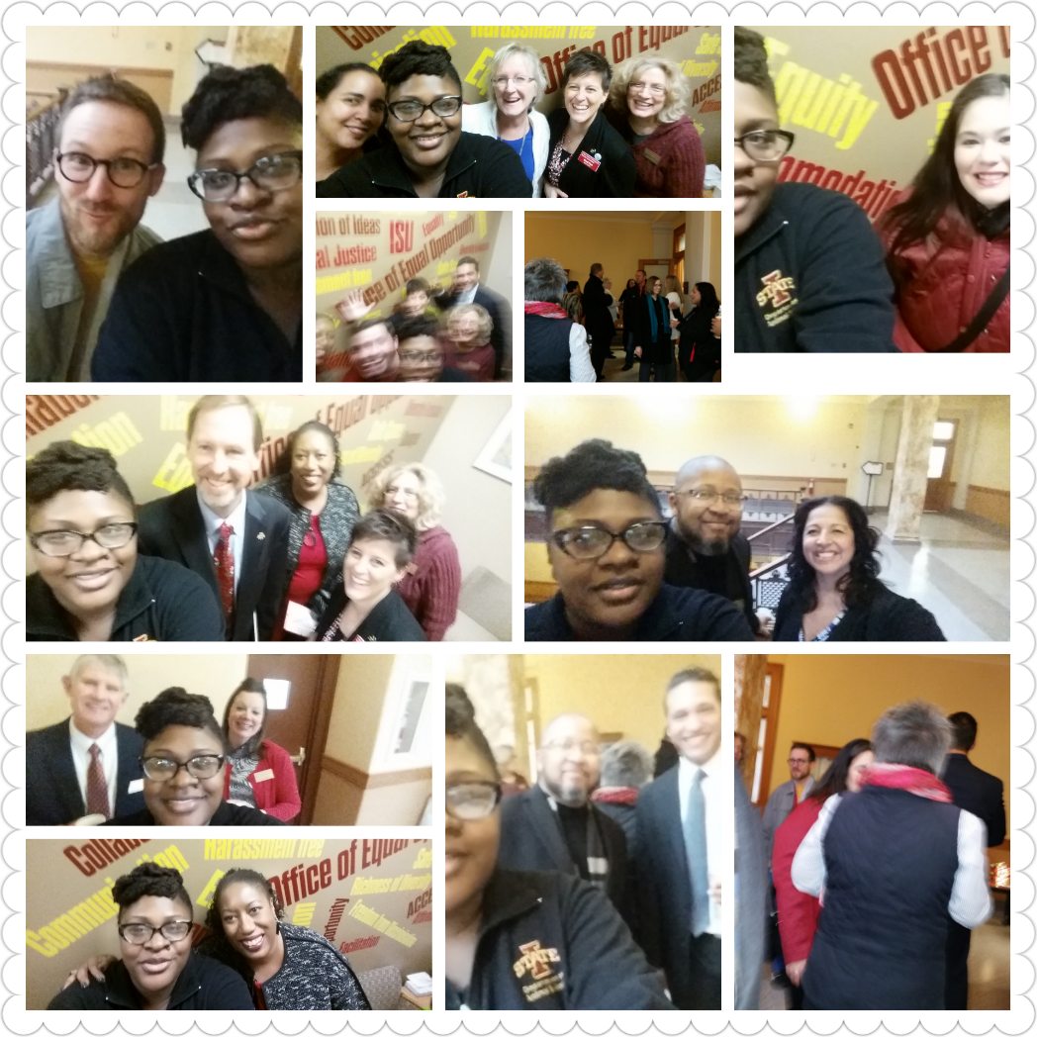
VPDI’s Open House

Slide 14
FSA Meetings
Black Faculty &Staff Association will meet Thursday, January 19, 2017 in the Gold Room, Memorial Union 12 pm

