Slide 1
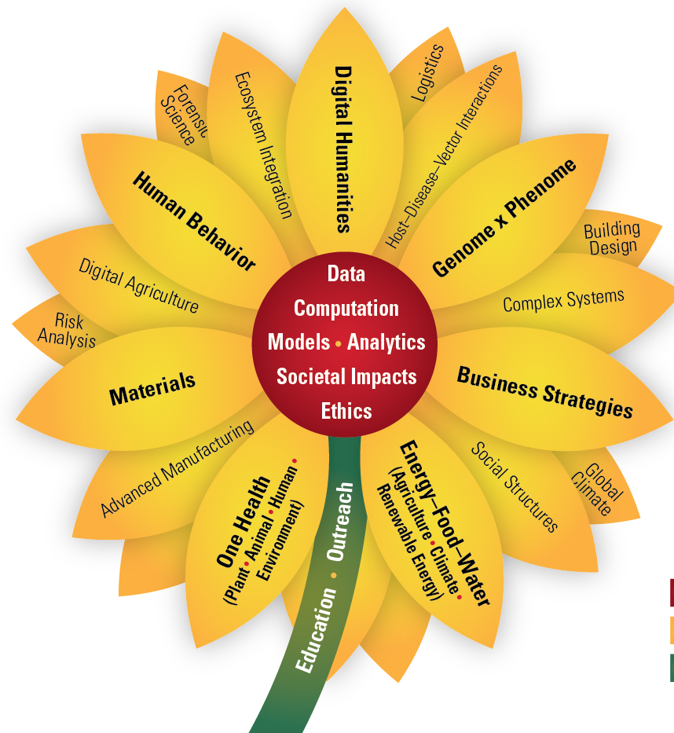
Update on ISU Research Mission
Sarah Nusser
Vice President for Research
Iowa State University
P&S Council, January 2017

Slide 2
Thank you!
Grant support staff, working closely with researchers and other units
Researchers, conducting research, mentoring personnel
For enabling faculty success and contributing to recent ISU research wins

Slide 3
ISU Strategic Plan Update
Goal 2: Enhance the ISU’s research profile by conducting high impact research that addresses the grand challenges of the 21st Century
Developing grand challenge research themes
New and ongoing internal funding programs for interdisciplinary research and instrumentation
Visioning team for arts & humanities
Facilities development (microscopy, greenhouse)
Capacity building for staff

Slide 4
Advancing Research Careers
Workshops & services
Finding research funding, developing proposals, managing awards
Team building, project management
SPECS training
Information sources
E-News (vprcomm@iastate.edu to sign up)
Grant Coordinators meetings
Tip sheets

Slide 5
Your Input?
What can we be doing for staff who are connected to the research mission?
ISU Strategic Plan
VPR initiatives
Other avenues

Slide 6
Thank you!
Sarah Nusser
Vice President for Research
Iowa State University

