Slide 1
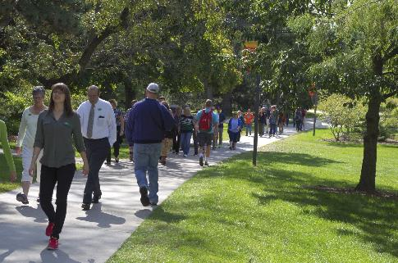
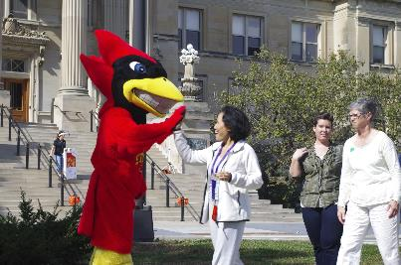
ISU WellBeing University Human Resources Update

Slide 2
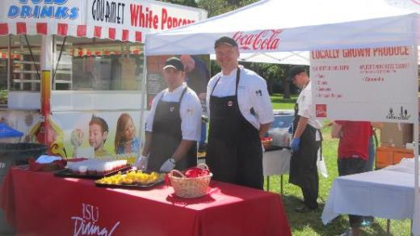
Phase 1: Engage the ISU Community
Completed Inventory of ISU
Health Care Claims, Surveys and Campus Conversations
Connected and Integrated with Partners
Internal UHR
Campus groups – Live Green, ISU Dining, College Human Sciences
Community – MGMC, McFarland, Healthiest Ames
Other – Health vendors, BHAC
Well-being Services & Collaborations
Local Food Festival
Healthiest State Walk
Flu Vaccinations
Workshops and trainings

Slide 3
ISU WellBeing Action Plan
Move from Wellness to Well-being
Six elements of well-being:
Mental (mind)
Physical (body)
Spiritual (spirit)
Emotional
Financial
and Community
Guiding Principles

Slide 4
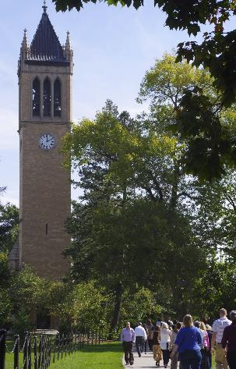
ISU WellBeing Action Plan
Phased approach over five years
Five strategic priorities
Improve the health status of our employees
Enable employees to adopt and maintain healthy lifestyle choices
Create a safe and supportive environment that makes healthy choices easy
Educate and empower our employees to effectively manage and utilize the health care system
Foster an inclusive and engaging culture of well-being that enables employees to bring their best self to work and life every day

Slide 5
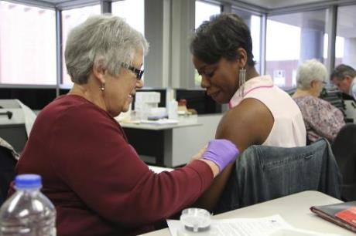
Phase 2: Enhance our Programs and Services
Launch Benefits & Wellness Communications
ISU WellBeing Website (January) - Programs, services and resources
Annual Program Calendar - Workshops in Learn@ISU
Benefits, EAP, L&D, Financial webinars/programs, Well-being programs and services
Well-being Workshop Series (April)
ISU WellBeing Partner Forum (April)
Well-being Portal (November) – a website with personal tools, tracking, and apps
Develop Chronic Condition Support program
Community partnership on chronic health condition (e.g., diabetes, hypertension) support
(MGMC, McFarland Clinic, City of Ames, ISU, and Wellmark)
Hire Registered Dietician Nutritionist (April)
Host Healthiest State Conference at ISU (May)
Continue Well-being Services
P&S Development Conference (February)
Healthiest State Walk and Flu Shots (October)
Offer Medical Self Care Program (2017)

Slide 6
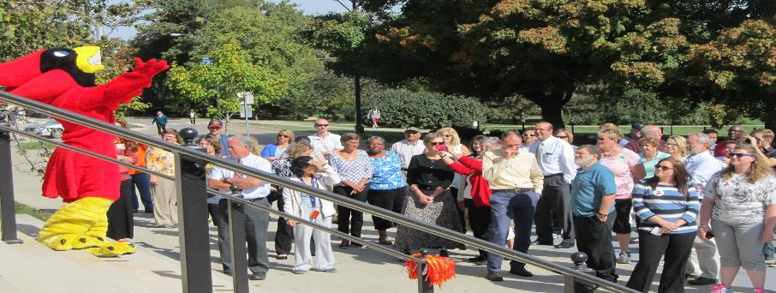
Future Phase 3: Expand The Opportunities and Ideas
Blood Pressure stations
Health Care Consumerism
Biofeedback/Stress Management stations…
Walking Clubs and Walking paths
Partnering: Bike Share program development
New ideas…..

