Slide 1
Professional & Scientific Council Update
September 1, 2016

Slide 2
UHR Priorities Timeline
July-16 | Aug-16 | Sep-16 | Oct-16 | Nov-16 | Dec-16 | Jan-17 | Feb-17 | Mar-17 | Apr-17 | May-17 | June-17
ERP HCM
Analysis/ Phase 0 until contract signed
FLSA
Class Comp Review to meet FLSA Regulations
Class Comp Review
Planning Timekeeping Practices
Timekeeping Implementation
Ongoing Support
UHR Initiatives
First Report of Injury (Origami) Implementation
Talent Acquisition Enhancements (HERC, PA Mobile Site, …)
Redesign/Launch of UHR Website
Well Being Portal Implementation
Scanning of Personnel Files
Human Capital Capabilities Assessment & Analyses
Facilitating Human Capital Capabilities & Partnerships to advance priorities across campus (eData, open forums, meetings, …)
Background Check Audit Follow up

Slide 3
P&S Classification/Compensation Review
Review current P&S jobs and pay structure that enables the attraction, retention, and reward priorities at Iowa State and is fair, equitable and compliant.
Expected Outcomes:
Defined job categories and job families for P&S jobs and establish alignment with new FLSA regulations;
Defined pathways for P&S career development;
Defined P&S pay structure (including a nonexempt pay structure) that balances market, equity, and performance; and
Defined pay administration practices and policies to maintain the pay program.
In Progress: Evaluation of consulting partners for a comprehensive review of the P&S classification
Phase 1: Meet the December 1, 2016 timeline for FLSA changes

Slide 4
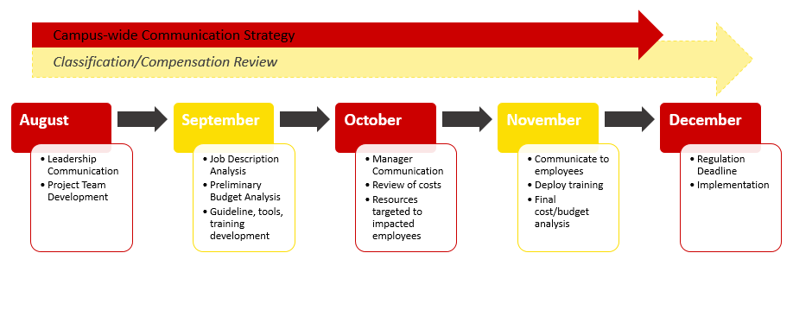
FLSA Project Timeline – Phase 1

Slide 5
FLSA Project Overview
The Core Team: Advisory group comprised of experts that will assist with coordinating the sub-teams and synthesizing information to be shared with executive leadership.
Discuss enterprise wide issues and priorities
Scope the project for a successful implementation on December 1
Define and identify long-term FLSA enhancements
Coordinates communication across stakeholders groups
Engages with Implementation and Time sub-teams for collaboration

Slide 6
FLSA Project Overview
Implementation Team: Provide feedback and create strategies to support a successful implementation with stakeholder engagement.
Make strategy recommendations to the Core Team
Create and implement a process for gathering feedback on tools, training, communication, etc.
Develop communications for various stakeholders
Advise on workplace culture considerations associated with implementation and develop solutions
Collaborate with Time Team as necessary to provide seamless tools and information

Slide 7
FLSA Project Overview
Time Team: Work towards the development of the appropriate tools and processes in support of tracking hours worked for the impacted group.
Subcommittee of the Implementation Team.
Make recommendations to the Core Team
Collaborate as necessary with Implementation Team to provide seamless tools and information
Create and implement a process for gathering feedback on tools, training, communication, etc. related to the tracking of hours worked
Define and implement a process for the compliant tracking of hours worked

Slide 8
Questions and Comments

