Slide 1

General Council Meeting
January 6, 2022 2:10 – 4:00 p.m.
Online via Webex
Online: Councilors, please stay muted with camera off, unless speaking, to preserve bandwidth and cut down on noise.
Thank you to all!

Slide 2
Call to Order & Seating of Substitutes
Establish Quorum (Sarah Larkin)
Approval of the Agenda
Approval of the Minutes
December 2, 2021 general council meeting minutes
Welcome, and thank you for joining our virtual meeting!
Please stay muted and keep your camera turned off unless you are speaking.
These efforts preserve bandwidth and cut down on outside noise and distraction to provide a better experience for everyone in the meeting.

Slide 3
Administrative Reports
Dwaine Heppler, Ed Holland
University Human Resources
Welcome, and thank you for joining our virtual meeting!
Please stay muted and keep your camera turned off unless you are speaking.
These efforts preserve bandwidth and cut down on outside noise and distraction to provide a better experience for everyone in the meeting.

Slide 4
WorkFlex
Professional & Scientific Council
January 7, 2022

Slide 5
Key Information
Important Dates
  Employee request deadline: November 26, 2021
  Staff appointing authority approval deadline: December 22, 2021
  WorkFlex arrangement effective date: January 18, 2022
Data and Reporting
  Initial round of requests utilized a custom request process in Workday
  Workday offers a standard business process for flexible work arrangements that is planned for use in the spring application window
  Due to the custom process used, reporting is limited

Slide 6
Divisional Utilization of WorkFlex
15% utilization in the first window
Academic Affairs leveraged the program the most (20%)
Student Affairs leveraged the least (6%)
Division | WorkFlex Requests | Eligible Workers | % of Eligible
SVPP | 524 | 2641 | 20%
SVPOF | 91 | 845 | 11%
SVPSA | 36 | 594 | 6%
PRES | 49 | 577 | 8%
Total | 700 | 4657 | 15%

Slide 7
Duration of Requested Arrangements
Division | Spring | Spring + Summer | Spring + Summer + Fall | Spring 2023* | Grand Total
SVPP | 227 | 93 | 203 | 1 | 524
SVPOF | 7 | 1 | 83 |  | 91
SVPSA | 18 | 2 | 15 | 1 | 36
PRES | 2 | 3 | 44 |  | 49
Total | 254 | 99 | 345 | 2 | 700
Highest number of arrangements approved for a full year, but many limited to Spring
Durations requested through Spring 2023 are being adjusted to last no longer than 1 year

Slide 8
Arrangement Types
Arrangement(s) Requested | Denied | In Progress | Successfully Completed | Grand Total
How to Work > Gradual Return to Work | 1 |  |  | 1
How to Work > Gradual Return to Work Where to Work > Remote Hybrid |  | 1 |  | 1
How to Work > Reduce Hours | 1 | 5 | 2 | 8
How to Work > Reduce Hours When to Work > Compressed Workweek Where to Work > Remote Hybrid |  | 1 |  | 1
How to Work > Reduce Hours When to Work > Flexible Start/Stop Times or Flex Day Where to Work > Remote Hybrid |  |  | 1 | 1
How to Work > Retirement Transition | 1 | 1 |  | 2
When to Work > Compressed Workweek | 3 | 25 |  | 28
When to Work > Compressed Workweek When to Work > Flexible Start/Stop Times or Flex Day | 1 |  |  | 1
When to Work > Compressed Workweek When to Work > Flexible Start/Stop Times or Flex Day Where to Work > Remote Hybrid |  | 15 |  | 15
When to Work > Compressed Workweek Where to Work > Remote Hybrid |  | 12 |  | 12
When to Work > Flexible Start/Stop Times or Flex Day | 14 | 40 | 15 | 69
When to Work > Flexible Start/Stop Times or Flex Day Where to Work > Remote Hybrid | 1 | 71 | 7 | 79
Where to Work > Remote Hybrid | 20 | 430 | 32 | 482
Grand Total | 42 | 601 | 57 | 700
Arrangements including Remote Hybrid options were the most selected with over 84% of requests including Remote Hybrid
Compressed Workweek was the second highest arrangement type requested at 8%
6% of requests were denied, some still awaiting supervisor or staff appointing authority approval
HR Delivery continues to work with leaders to ensure all requests are dispositioned

Slide 9
Next Steps
HR Delivery will continue to work with employees and supervisors as questions about current and potential future WorkFlex arrangements come to light.
HR Delivery staff will audit completions, complete final approval and kick off any required agreements or acknowledgements to be finished by EOD January 14, 2022
UHR and Leadership will be monitoring the program to determine if any modifications are necessary, but given the fact most arrangements will not even go into effect until January 18th, few changes are likely to be added to the program in the next window.

Slide 10
Where to Go for Help
WorkFlex program documents and guidance materials can be found at:
  https://worklife.hr.iastate.edu/workflex
Contact your HR Partner or HR Coordinator for assistance by emailing HR_Delivery@iastate.edu or by contacting them directly
We encourage you to work with your HR Delivery staff on any questions you may have on the WorkFlex program.

Slide 11
Administrative Reports
Scott Butterfield
IT Services Manager for Change Management
Welcome, and thank you for joining our virtual meeting!
Please stay muted and keep your camera turned off unless you are speaking.
These efforts preserve bandwidth and cut down on outside noise and distraction to provide a better experience for everyone in the meeting.

Slide 12
Workday Today

Slide 13
Workday Changes
Homepage Updates
Workday Assistant
Configurable Searches
Notes:
Today we’re going to look at the People Experience upgrades in Workday

Slide 14
Homepage Updates
Notes:
Workday Today will be the new homepage for all users coming January 10, 2022.
With this upgrade, system users will participate in a more personalized experience on their homepage. Key tasks, applications, and work recommendations surface to visible sections on the homepage for the user to find more easily. Additionally, machine learning algorithms have been incorporated into the system to recognize the most common tasks and applications accessed by an individual user, and conveniently displays these items directly on the home page.

Slide 15
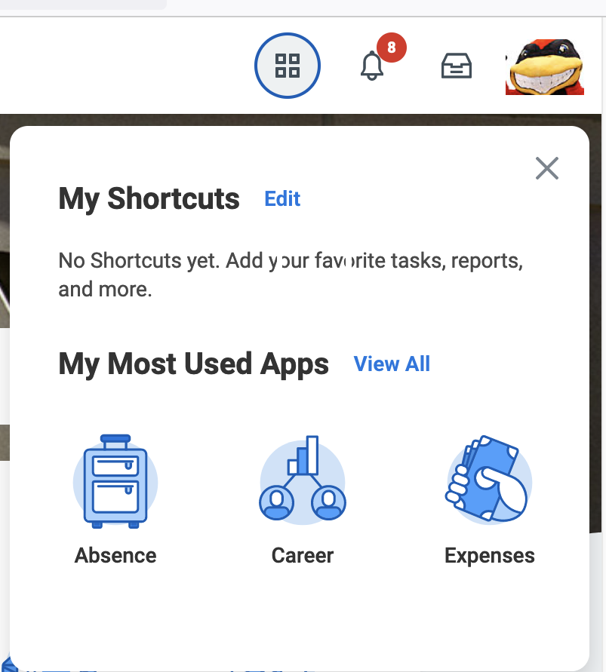
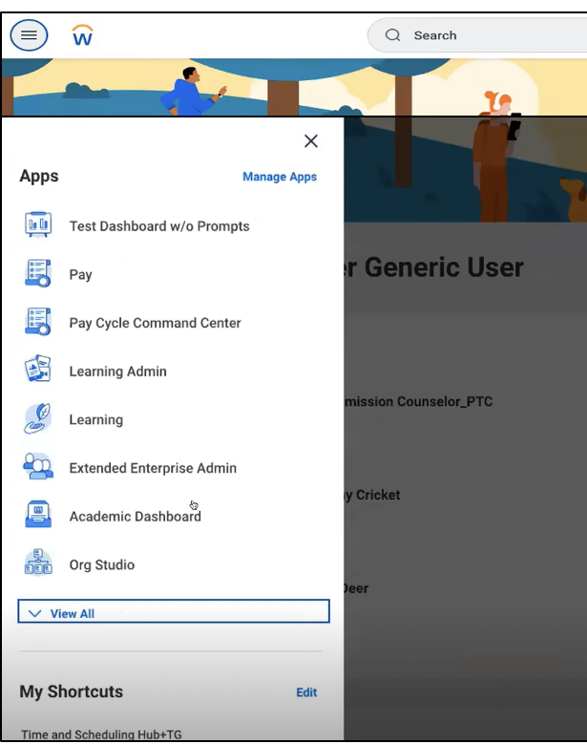
Workday Homepage Updates
Quick access button moves to left corner
Current location (Upper right)
New location (Upper left)
Notes:
Workday is changing the location of the quick access button, moving from the top right to the top left side of the screen. Using the quick access button in the top left side of the screen will open a list of all applications and shortcuts.

Slide 16
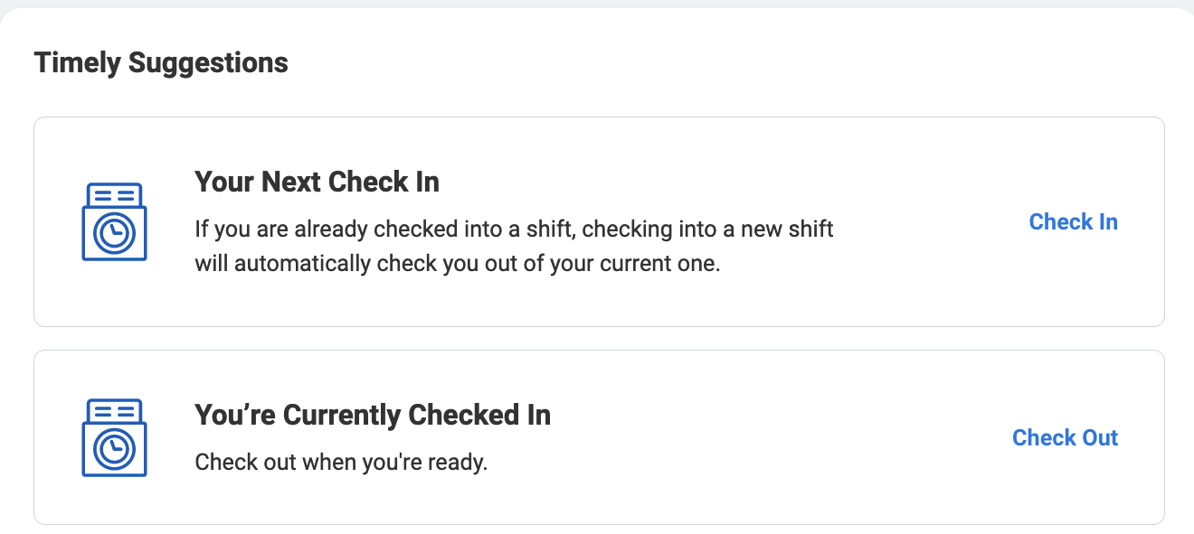
Workday Standard Cards Example
Workday Time
  Check In/Check Out
  Unsubmitted Time
  Unapproved Time
Notes:
Workday Time is an example of configured cards. These cards allow hourly users to check in and check out of work from their home page. After an hourly user checks in, Workday displays the Check Out card. After the hourly user checks out, Workday displays the Check In card. Your Next Check In card is enabled when a user has multiple campus positions. It will prevent consecutive check ins.
Managers have a personalized card for unapproved time. These cards reduce the number of clicks to check in and out and approve team members hours.

Slide 17
Workday Standard Cards
Team Management
  Approve Timesheets
  Team Anniversaries
  Team Birthdays
  Team Clock Status
Time Off
  Upcoming Time Off
Time Entry
  Check In/Check Out
  Unsubmitted Time
  Unapproved Time
Pay
  View Available W-2
  Pay slips
Personal Information
  Change Contact Information
  Change My Home and Work Contact
  Change My Work Contact
Notes:
As before, Announcements, External Links, and Worklets are displayed on the Home page. And now, Workday is introducing Cards as a new item to display on the homepage as part of the Workday Today People Experience. Cards are timely, personalized content to help users identify what they need to do, and when it should be done. Workday standard cards include team members’ birthdays, anniversaries, pay slips, and upcoming time off.

Slide 18
Homepage Updates
Awaiting Your Action
Your Team
Quick Tasks
Notes:
Awaiting your Action (AKA: Inbox) These are inbox items that the user needs to act on. While the users can still access their inbox in the global header, this section displays prominently on the homepage to highlight a user’s most urgent tasks. This was done so that the user would be less likely to miss items that need to be completed in their account.
Your Team This section is for configured cards. The cards displayed in this section remind managers to approve time for hourly team members, celebrate team members birthdays and anniversaries, and be reminded of team absences. If users are not supervisors, this section will not appear.
Quick Tasks: (AKA: Suggested Tasks) The Workday machine learning algorithm recognizes the tasks you perform daily in Workday and automatically suggests these tasks in this section of the homepage. The user’s top three most frequently performed tasks will display in this section. It can take a few weeks for these to generate. In the meantime, the system will automatically generate three for display in the Quick Tasks section.

Slide 19
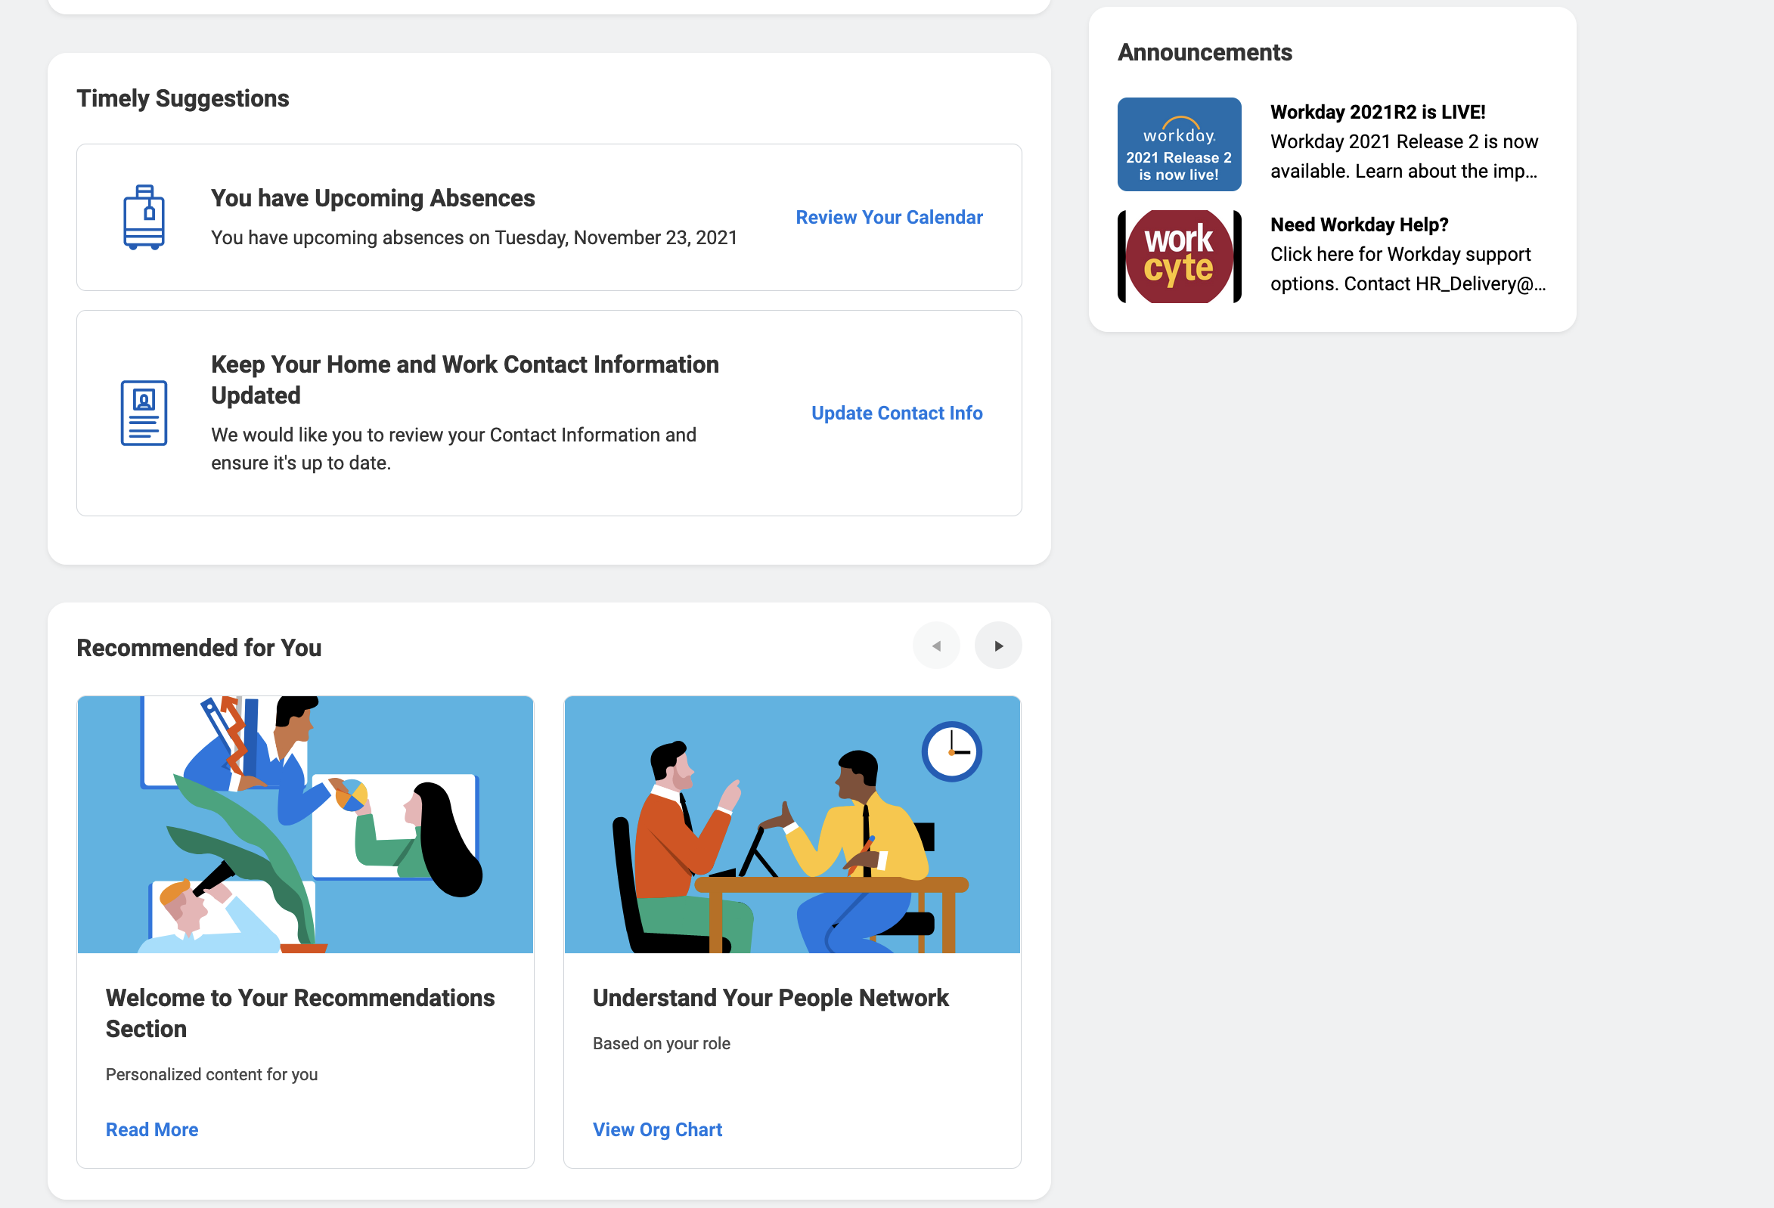
Homepage Updates
Timely Suggestions
Recommended for You
Announcements
Notes:
Timely Suggestions: This section is for configured cards. The cards displayed in this section provide actionable items from Workday data. Examples of cards a user might see here include: a reminder to “Add credit card transactions to Expense Report,” or a new pay slip is available.
Recommended for You: This section is designed to help users learn more about Workday at a moment that is most relevant for that user. The cards shown in this section guide users to additional resources located within the system. The recommendations are based on an internal algorithm that identifies the learning needs of the user- (or assigns learning based on other employees that are similar to the user.)
Announcements: The announcements section is moving to the right side of the page. This section can now host embedded videos. Workday developers researched where the best location for this section would be BEFORE making this move. They feel confident that this is the best place for it.

Slide 20
Workday Assistant
Notes:
Workday Assistant is a chatbot that will empower self-service users by providing easy access to common Workday personnel tasks and data.
The chat bot will meet users right where they are at- whether that be their desktop or mobile device.

Slide 21

Workday Assistant
Empowers Self-Service for Personal Personnel Requests
Conversational Experiences
  Natural Language Understanding
Machine Learning Algorithm
Notes:
The user is invited to have a conversation with the chat bot, where the bot is programmed to recognize common language, and connect the request to possible Workday tasks. To do this, Workday Assistant utilizes natural language understanding. This means the user doesn’t need to know the exact name of a Workday task to connect with a helpful response.
Workday Assistant is intelligent and driven by machine learning algorithms. The bot learns from the questions users ask the system to improve future responses. By providing only the answers users would like to see, complex tasks become simple to complete.

Slide 22
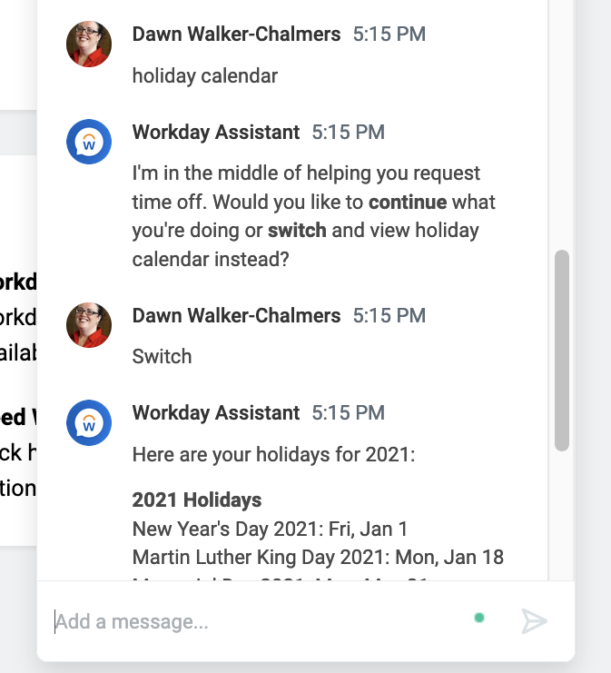
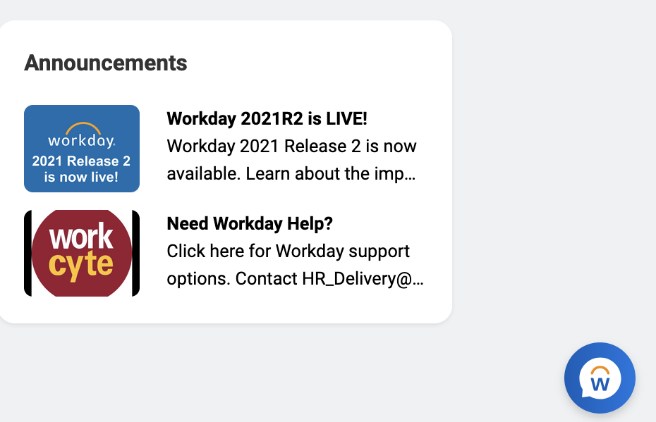
Workday Assistant
To open Workday Assistant, select icon in lower right corner on any Workday page.
Then, ask a question about your personal work needs.
Notes:
Workday Assistant can be enabled from any page in Workday. Workday Assistant is limited to a user’s personal information. As one wise ITS member said, Workday Assistant is ”about you and not what you do.” A user can ask for their W2, request time off, or view insurance policies.

Slide 23
Workday Assistant Capabilities
Benefits
  View Dependents
  View Benefits
Expenses
  View Expense Reports
Human Resources
  Email
  Phone
  Office Location
  Contact Information
  Title
  Manager
Pay
  View Direct Deposit
  View Pay Information
  View Tax Forms
  View W-4
Personal Data
  Location
  Title
  Manager
  Birthday
  Hire Date
  Anniversary
  Time in Position
  Promotion Date
  Employee ID
  Org Details
  Legal Name
  Preferred Name
  Profile Photo
  Emergency Contacts
Procurement
  View Orders
Productivity
  Open My Drive
Recruiting
  View Candidate Status
Team Management
  Team Members
  Team Anniversaries
  Team Birthdays
  Team Clock Status
  Team Hire Dates
  Team Promotion Dates
  Team Time Off
  Team Time in Position
Time Off
  Holiday Calendar
  Request Time Off
  View Time Off Balance
Time Tracking
  Approve Timesheets
  Check In/Check Out
  Enter Time
Notes:
Here is a detailed list of the Workday Assistant capabilities.

Slide 24
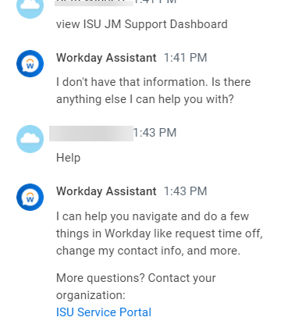
Workday Assistant Limitations
The functions of the chatbot are limited and users will encounter stopping points.
Department specific reports
Dashboards
University specific functions
HELP search will yield link to ISU Service Portal.
Notes:
While the Workday Assistant does a wonderful job helping users quickly connect to common Workday tasks and information, please be aware that the Workday Assistant does have LIMITATIONS. The Workday Assistant is here to help users as an ISU Employee, but it’s not as powerful when it comes to helping if the user’s job requires digging deeper into Workday details and information. Workday Assistant is unable run dashboards and detailed reports created for specific ISU departments.
A user can always type in HELP and they’ll find a link to the ISU Service Portal so they can quickly get the help they need.

Slide 25
Configurable Search
Notes:
Workday Today will provide users with a more personalized search experience.

Slide 26
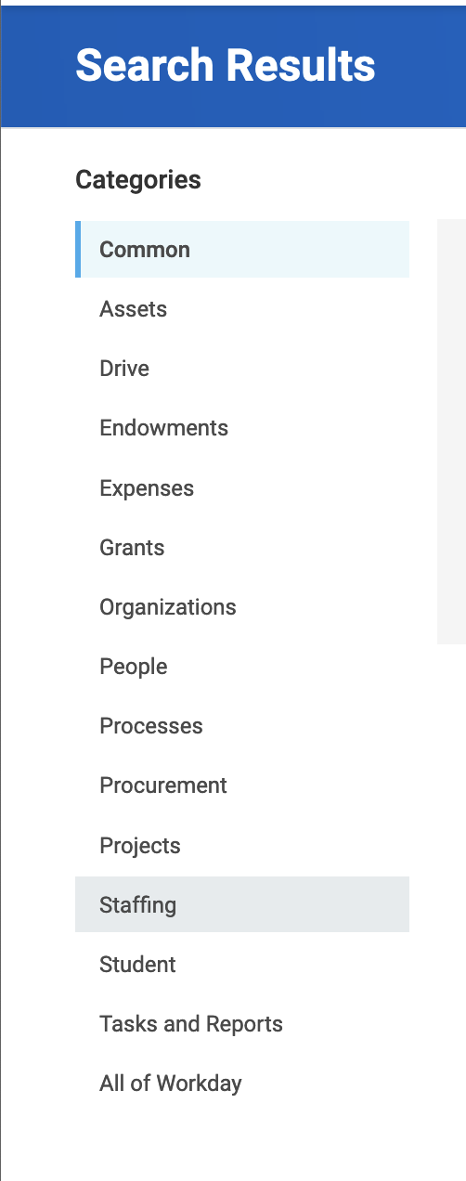
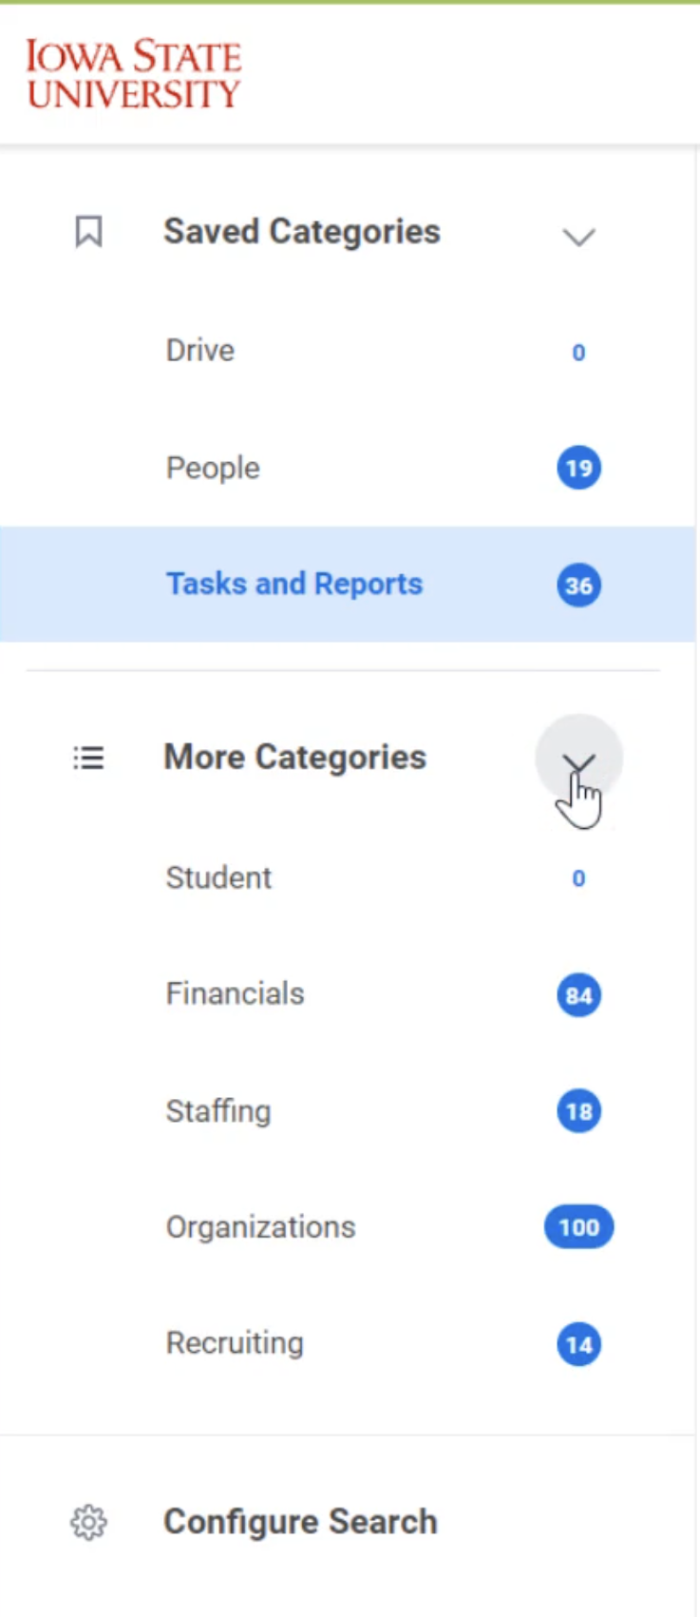
Search Landing Page Updates
Reduced number of search categories and addition of badges
Current menu for search results
New menu for search results
Notes:
Currently, the Workday search function provides helpful search categories to filter results.
Enhancements are coming to Workday’s search function to help produce more efficient and accurate search results. On the search results page, the left menu has been reduced to a more condensed list that is customizable. Badges have been added to identify the number of returns for each search category.

Slide 27
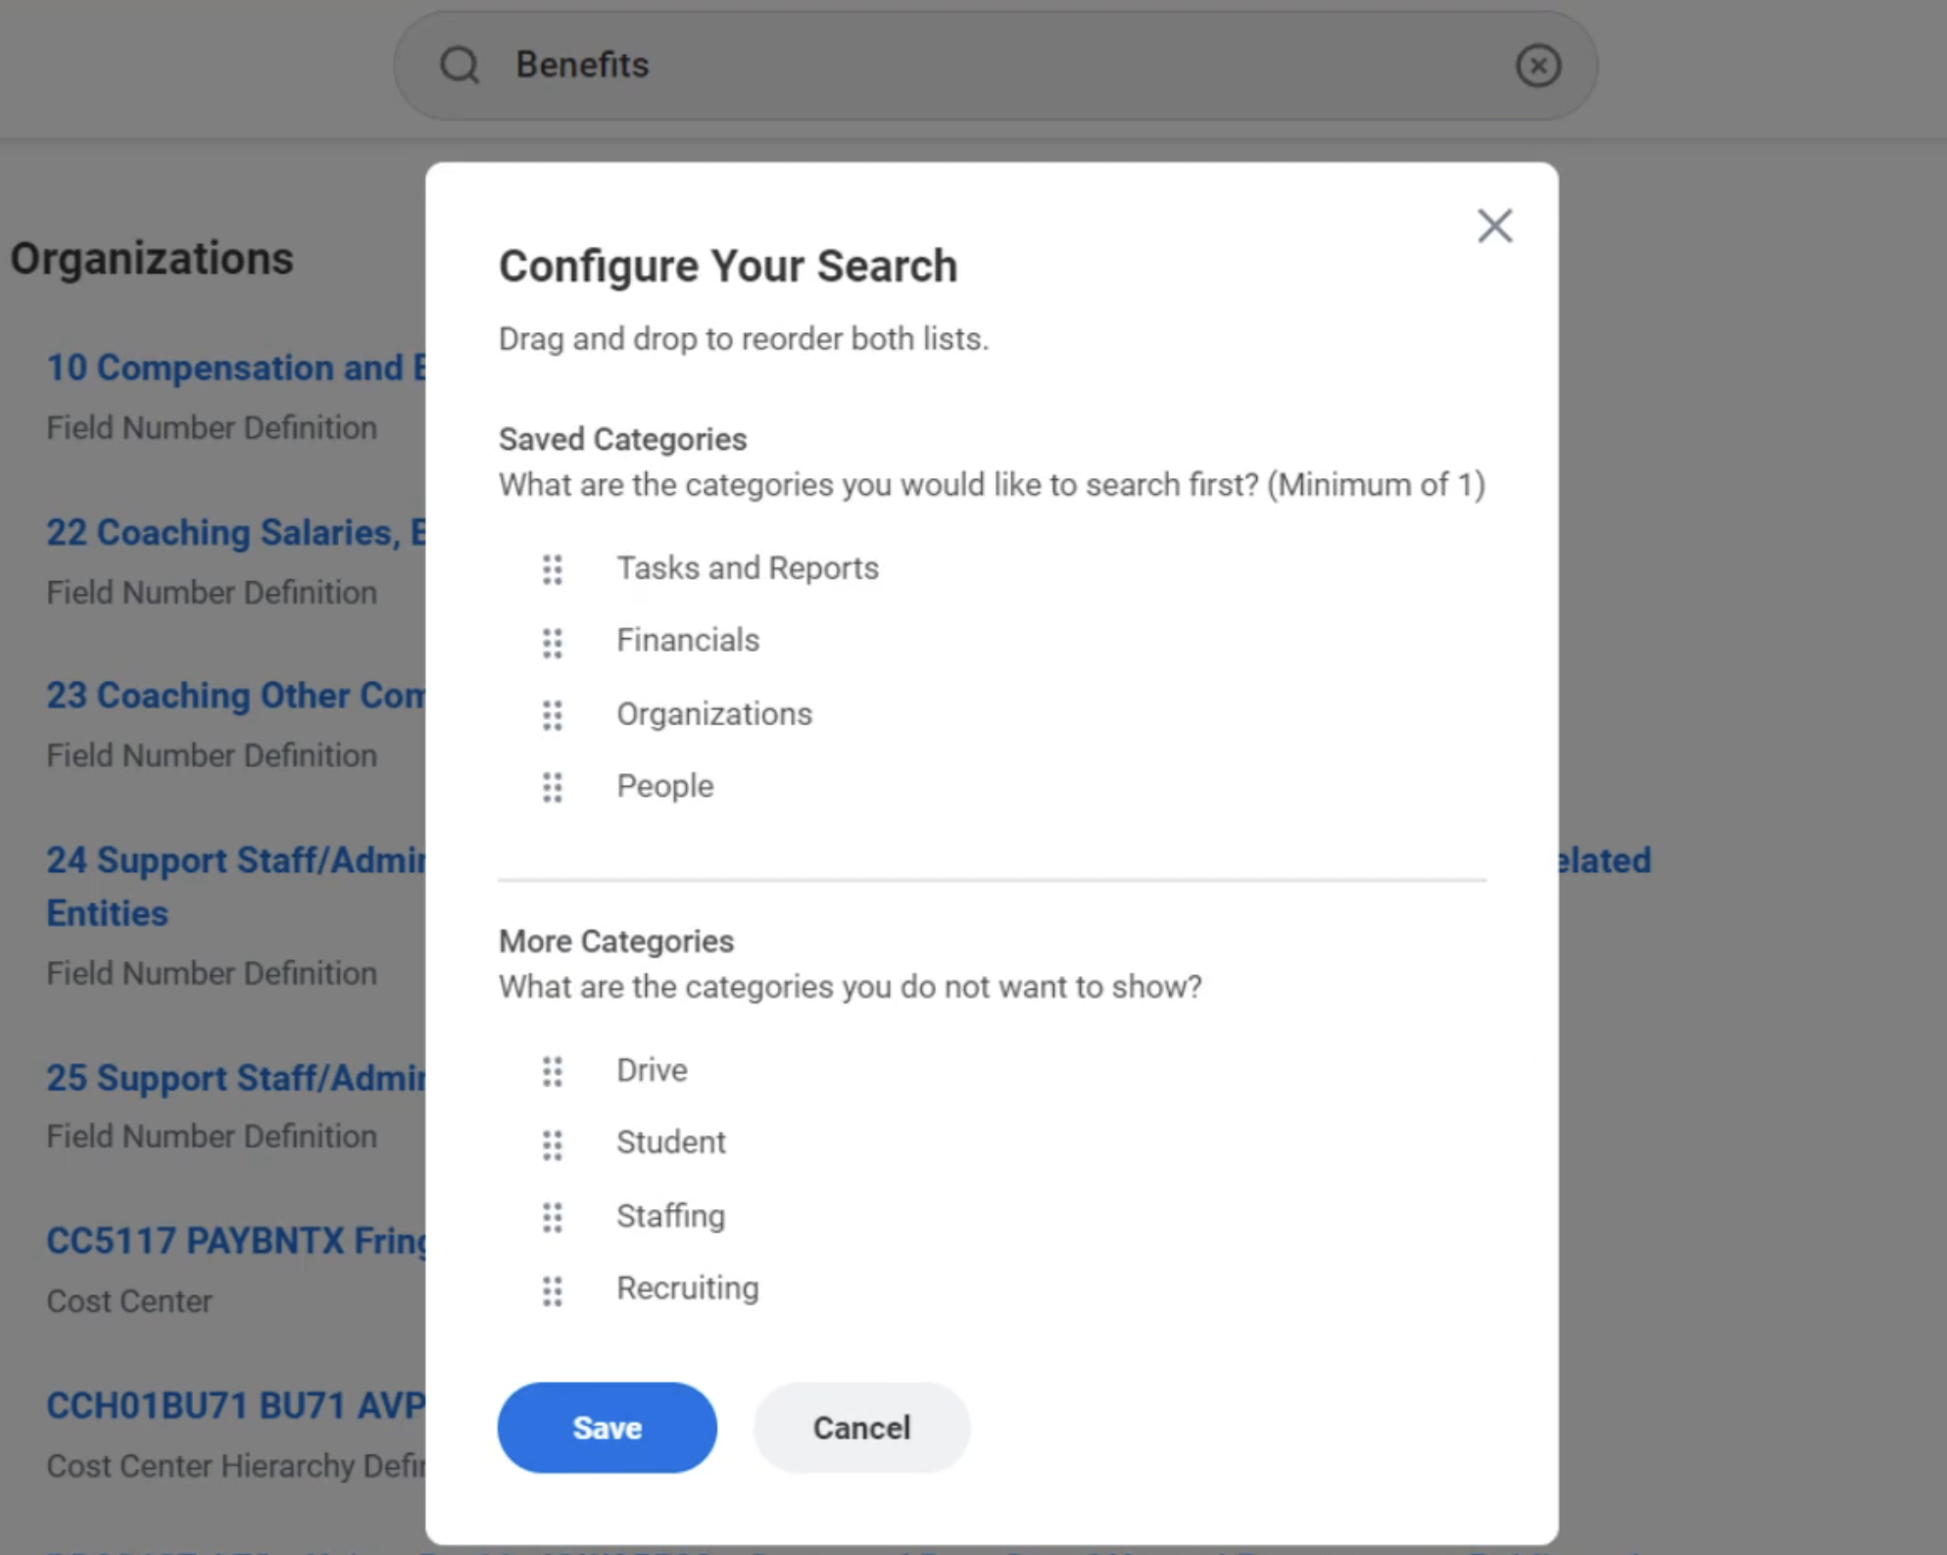
Search Landing Page Updates
Customizable search results menu
Notes:
With the Workday Today update, system users can customize search categories on the left search results menu. Select configure search from left menu and a pop-up prompt will open. In the prompt, users can reorganize the left menu search results menu.

Slide 28
Workday Today
Go Live Date
January 10, 2022
Notes:
Workday Go Live date is January 10, 2022

Slide 29
Need Help?
Virtual Office Hours
Date: January 10th
Time: 8:00AM - 5:00PM
Location: Webex
iastate.webex.com/meet/dswalker
Email: workcyte_feedback@iastate.edu
Virtual Office Hours
Date: January 12th
Time: 8:00AM - 5:00PM
Location: Webex
iastate.webex.com/meet/dswalker
Email: workcyte_feedback@iastate.edu
Notes:
The Change Management Team will host virtual office hours to help campus users through the Workday Today changes.
Email: workcyte_feedback@iastate.edu
Webex Location: https://iastate.webex.com/meet/dswalker

Slide 30
Questions?

Slide 31
Professional and Scientific Council
Executive Committee Reports
President – Chris Johnsen
Secretary/Treasurer – Sarah Larkin
Vice President for Equity and Inclusion – Jahmai Fisher
Vice President for University Community Relations – Gayle Mastbergen (for John Burnet-Larkins)
Vice President for University Planning and Budget – John Hascall
Welcome, and thank you for joining our virtual meeting!
Please stay muted and keep your camera turned off unless you are speaking.
These efforts preserve bandwidth and cut down on outside noise and distraction to provide a better experience for everyone in the meeting.

Slide 32
Professional and Scientific Council
Committee Reports
Awards – Susy Ankerstjerne
Communications – Deanna Sargent
Compensation and Benefits – Patrick Wall
Peer Advocacy – Jacob Larsen
Policies and Procedures – Paul Easker
Professional Development – Matthew Femrite
Representation – Jason Follett
Welcome, and thank you for joining our virtual meeting!
Please stay muted and keep your camera turned off unless you are speaking.
These efforts preserve bandwidth and cut down on outside noise and distraction to provide a better experience for everyone in the meeting.

Slide 33
Unfinished Business and General Orders
Welcome, and thank you for joining our virtual meeting!
Please stay muted and keep your camera turned off unless you are speaking.
These efforts preserve bandwidth and cut down on outside noise and distraction to provide a better experience for everyone in the meeting.

Slide 34
New Business

Slide 35
Open Discussion for the Betterment of Council
Welcome, and thank you for joining our virtual meeting!
Please stay muted and keep your camera turned off unless you are speaking.
These efforts preserve bandwidth and cut down on outside noise and distraction to provide a better experience for everyone in the meeting.

Slide 36
Announcements
Announcements from Councilors
Seminar Series Event: Non-diet, Weight Inclusive Approaches to Well-being:
Learn how to establish food freedom and body liberation, January 11,2022, 2-3 PM, 3580 Memorial Union/WebEx
Executive Committee Meeting
January 20, 10 a.m. – noon, 206 Durham
General Council Meeting
February 3, 2022 2:10 p.m. - 4 p.m. 3580 Memorial Union/ WebEx
Welcome, and thank you for joining our virtual meeting!
Please stay muted and keep your camera turned off unless you are speaking.
These efforts preserve bandwidth and cut down on outside noise and distraction to provide a better experience for everyone in the meeting.

Slide 37
Adjournment
Welcome, and thank you for joining our virtual meeting!
Please stay muted and keep your camera turned off unless you are speaking.
These efforts preserve bandwidth and cut down on outside noise and distraction to provide a better experience for everyone in the meeting.

